Slide 1

NPTEL
Applied Accelerated Artificial Intelligence
Instructor: Dr. Satyajit Das
Dept. of Computer Science and Engineering
Indian Institute of Technology Guwahati, Assam, India

Slide 2
Segment 4: DataLoader — Feeding the Model Efficiently
The bridge between your data on disk and your model on GPU — and why getting this right matters as much as the model itself

Slide 3
Learning Objectives — Segment 4
01
Write a custom torch.utils.data.Dataset for any file format by implementing __len__ and __getitem__
02
Configure DataLoader correctly: batch_size, shuffle, num_workers, pin_memory, drop_last
03
Apply torchvision transforms for image preprocessing: normalise, random crop, flip, colour jitter
04
Diagnose DataLoader bottlenecks using GPU utilisation and simple timing
05
Understand why the DataLoader can be the single biggest bottleneck in a training job

Slide 4
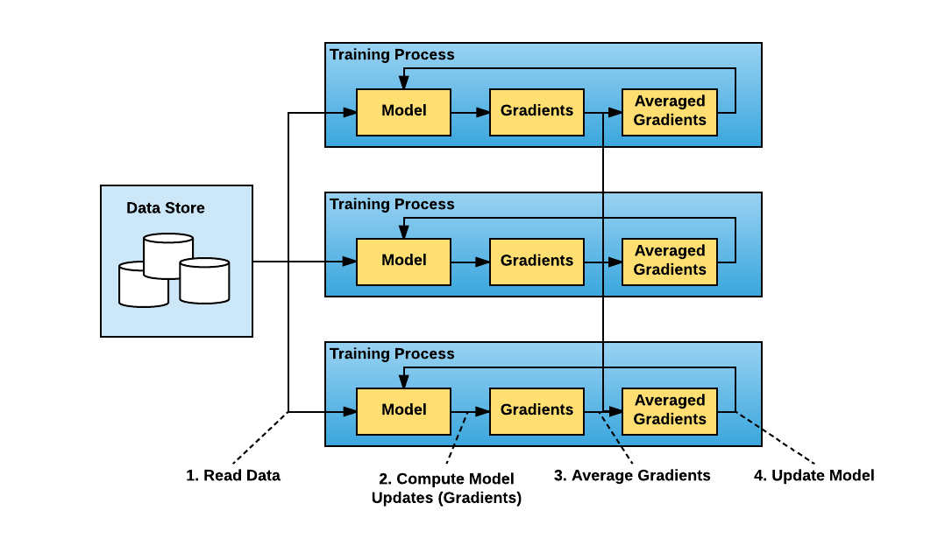

Slide 5
torch.utils.data.Dataset: Teaching PyTorch How to Read Your Data
The Dataset Contract
Subclass torch.utils.data.Dataset and implement exactly two methods:
__len__(self): returns the total number of samples in the dataset
__getitem__(self, idx): returns one (input, label) pair for integer index idx
PyTorch's DataLoader calls these methods automatically — you never call them directly
Minimal Dataset: Image Classification
from PIL import Image
import torch
from torch.utils.data import Dataset
class ImageDataset(Dataset):
def __init__(self, image_paths, labels, transform=None):
self.paths = image_paths # list of file paths
self.labels = labels # list of integer class IDs
self.transform = transform # torchvision transforms
def __len__(self):
return len(self.paths)
def __getitem__(self, idx):
img = Image.open(self.paths[idx]).convert('RGB')
label = self.labels[idx]
if self.transform:
img = self.transform(img) # returns tensor
return img, torch.tensor(label, dtype=torch.long)
Dataset for NLP (tokenised text)
class TextDataset(Dataset):
def __init__(self, texts, labels, tokenizer, max_len=128):
self.encodings = tokenizer(
texts,
truncation=True,
padding='max_length',
max_length=max_len,
return_tensors='pt',
)
self.labels = torch.tensor(labels)
def __len__(self):
return len(self.labels)
def __getitem__(self, idx):
item = {k: v[idx] for k,v in self.encodings.items()}
item['labels'] = self.labels[idx]
return item
Using torchvision.datasets for Common Benchmarks
from torchvision import datasets
train = datasets.CIFAR10(root='data', train=True,
download=True, transform=transform)
test = datasets.CIFAR10(root='data', train=False,
download=True, transform=test_transform)
Also available: MNIST, ImageNet, COCO, STL10, CelebA, etc.
Ref: PyTorch Dataset and DataLoader Tutorial (pytorch.org/tutorials/beginner/data_loading_tutorial.html)

Slide 6
DataLoader: The Engine That Feeds Your GPU
DataLoader Constructor — Every Parameter Explained
from torch.utils.data import DataLoader
loader = DataLoader(
dataset, # your Dataset object
batch_size=32, # samples per batch
shuffle=True, # randomise order every epoch (training only)
num_workers=4, # parallel worker processes for __getitem__
pin_memory=True, # page-lock CPU memory for faster GPU transfer
drop_last=True, # discard final batch if smaller than batch_size
persistent_workers=True, # keep workers alive between epochs
prefetch_factor=2, # batches to pre-load per worker
)
Critical Settings You Must Get Right
shuffle=True for training; shuffle=False for validation (order matters for reproducibility)
pin_memory=True: enables direct DMA from CPU RAM to GPU — 2-3x faster than pageable memory
num_workers=0: single-process, safe for debugging. num_workers=4-8: parallel, much faster
drop_last=True: avoids BatchNorm issues with batch size 1 at epoch end
persistent_workers=True: saves 2-5 seconds per epoch by keeping workers alive
How the DataLoader Uses Your Dataset
Each epoch:
1. Sampler generates a shuffled list of indices: [42, 7, 1001, 3, ...]
2. BatchSampler groups them into batches: [[42,7,1001,3], [88,15,...], ...]
3. Worker processes call dataset.__getitem__(idx) for each index in parallel
4. Workers apply transforms, assemble tensors, and place them in a shared memory queue
5. Main process reads batches from queue and yields them to your training loop
Iterating the DataLoader
for epoch in range(num_epochs):
for batch_x, batch_y in train_loader:
# batch_x: (batch_size, C, H, W) — already a tensor
# batch_y: (batch_size,) — integer labels
batch_x = batch_x.to(device)
batch_y = batch_y.to(device)
# ... training step
Ref: PyTorch DataLoader Source: torch/utils/data/dataloader.py

Slide 7
Image Transforms: Preprocessing Your Data
Why Transforms?
Raw images from disk: PIL Images, varying sizes, uint8 pixels in range [0, 255]
Model input needs: PyTorch tensor, fixed size, float32, normalised to [-1, 1] or ImageNet stats
Training transforms: add data augmentation to reduce overfitting
Validation/test transforms: only deterministic preprocessing — no random augmentation
Standard Training Transform for ImageNet
import torchvision.transforms as T
train_transform = T.Compose([
T.RandomResizedCrop(224, # crop random region, resize to 224
scale=(0.08, 1.0)),
T.RandomHorizontalFlip(p=0.5), # 50% chance of flip
T.ColorJitter( # random colour distortion
brightness=0.4, contrast=0.4,
saturation=0.4, hue=0.1),
T.ToTensor(), # PIL (H,W,C) -> Tensor (C,H,W), [0,255]->[0,1]
T.Normalize( # subtract ImageNet mean, divide by std
mean=[0.485, 0.456, 0.406],
std=[0.229, 0.224, 0.225]),
])
Standard Validation Transform
val_transform = T.Compose([
T.Resize(256), # resize shorter side to 256
T.CenterCrop(224), # crop centre 224x224
T.ToTensor(),
T.Normalize(mean=[0.485, 0.456, 0.406],
std=[0.229, 0.224, 0.225]),
])
Why Normalise with ImageNet Statistics?
mean=[0.485, 0.456, 0.406]: the average RGB values across all ImageNet images
std=[0.229, 0.224, 0.225]: the standard deviation of RGB values in ImageNet
Normalising: brings pixel values to approximately N(0, 1) — models train faster and more stably
If training on your own dataset: compute mean/std from your training set, not ImageNet
torchvision v2: The Modern API
import torchvision.transforms.v2 as T2
transform = T2.Compose([
T2.RandomResizedCrop(224),
T2.RandomHorizontalFlip(),
T2.ToDtype(torch.float32, # handles ToTensor + float
scale=True),
T2.Normalize(mean, std),
])
v2 transforms operate on tensors, not just PIL — much faster, GPU-compatible
Common Augmentation Techniques and Their Purpose
RandomCrop / RandomResizedCrop: position invariance
RandomHorizontalFlip: left-right symmetry
ColorJitter: lighting condition robustness
RandomRotation: orientation robustness
RandomGrayscale: colour-irrelevant features
CutMix / MixUp: regularisation; improves generalisation
RandAugment / TrivialAugment: automatic augmentation policies
Ref: Shorten & Khoshgoftaar, A Survey on Image Data Augmentation, J Big Data 2019

Slide 8
Diagnosing DataLoader Bottlenecks
The Single Most Important Diagnostic: GPU Utilisation
Open a terminal alongside your training: nvidia-smi dmon -s u -d 1
Watch the SM% column every second. If it oscillates: 0% → 95% → 0% → 95% — your DataLoader is the bottleneck
The GPU is finishing batches faster than the DataLoader can deliver the next one — it is starving
Target: GPU SM% sustained above 85% with less than 10% variance
Step 1: The num_workers Sweep
Set num_workers=0 and measure step time. Then increase to 2, 4, 8 and re-measure each time.
If step time drops significantly with more workers: preprocessing is the bottleneck — increase workers
If step time stops improving after 4-8 workers: GPU compute or I/O is the bottleneck
Rule of thumb: start with num_workers = 4 per GPU; cap at physical CPU cores / num_GPUs
Step 2: Check pin_memory Impact
Add pin_memory=True and measure again — should give 1.2-1.5x speedup for GPU-heavy pipelines
If no speedup: PCIe transfer is not your bottleneck (compute-bound job)
Step 3: Isolate I/O vs Preprocessing
Benchmark __getitem__ alone: time a loop over dataset without DataLoader
If this is slow: storage is the bottleneck — cache processed data or switch to LMDB
If this is fast: collation or worker communication is slow
Step 4: The Dummy DataLoader Trick
# Replace your Dataset with a fast in-memory synthetic dataset
# If training suddenly reaches 95% GPU utilisation, real dataset is the bottleneck
class DummyDataset(Dataset):
def __len__(self): return 10000
def __getitem__(self, i):
return torch.randn(3,224,224), torch.tensor(0)
If dummy dataset makes GPU utilisation jump to 95%: your real dataset processing is the bottleneck
If dummy dataset still shows low utilisation: model or GPU is the bottleneck
Ref: PyTorch Performance Tuning Guide (pytorch.org/tutorials/recipes/recipes/tuning_guide.html)

Slide 9
Segment 4 Summary: DataLoader & Data Pipeline
Write a Dataset by subclassing torch.utils.data.Dataset and implementing __len__ and __getitem__. The DataLoader calls these automatically.
DataLoader key settings: shuffle=True (training), num_workers=4-8, pin_memory=True, persistent_workers=True, drop_last=True. Wrong defaults are the #1 source of accidental poor performance.
Training transforms add randomness (RandomCrop, Flip, ColorJitter) to reduce overfitting. Validation transforms are deterministic (Resize + CenterCrop + Normalize only).
Always normalise images with mean and std computed from your training dataset, or use ImageNet statistics [0.485, 0.456, 0.406] when fine-tuning pretrained models.
GPU SM% oscillation (0% to 95%) indicates DataLoader starvation. Fix by increasing num_workers. Use the dummy dataset trick to isolate whether dataset loading or GPU compute is the bottleneck.

Slide 10
Thank you!

